Slide 1

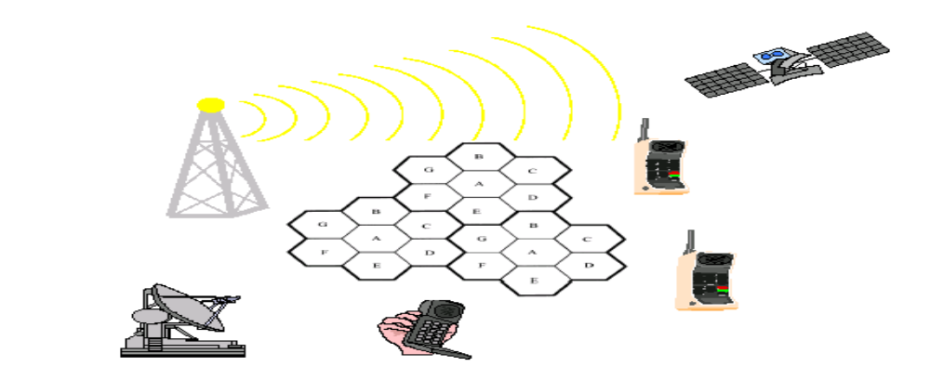
Chapter Three
Cellular network and Mobility Management
Wireless Networks

Slide 2
Introduction to cellular concept
Traditional mobile service was structured in a fashion similar to television broadcasting: One very powerful transmitter.
Television broadcasting: One very powerful transmitter located at the highest spot in an area would broadcast in a radius of up to 50 kilometers.
Drawbacks:
        High power consumption
        Large size of the mobile
        Low capacity
The Cellular concept is a system level idea which calls for replacing a single high power transmitter with many low power transmitters.
Each providing coverage to only small portion of the service area.
Notes:
Cellular network: replacing a single high power with many low power transmitter. Depends intelligent radio allocation and by reusing channel
Frequency reuse: the process of selecting allocating group channels for all base station and reusing channel is called fru

Slide 3
Frequency Reuse
Cellular radio systems rely on an intelligent allocation and reuse of channels throughout a coverage region.
Each cellular base station is allocated a group of radio channels to be used within a small geographic area called a cell.
Base stations in adjacent cells are assigned channel groups which contain completely different channels than neighboring cells.
By limiting the coverage area to within the boundaries of a cell, the same group of channels may be used to cover different cells that are separated from one another by distances large enough to keep interference levels within tolerable limits.
The design process of selecting and allocating channel groups for all of the cellular base stations within a system is called frequency reuse or frequency planning.
Notes:
Small number of cell(N) maximum capacity
Frequency reuse: the concept of using the same radio frequencies with a given area, that is separated by considering distance within minimum interference to stablish communication

Slide 4
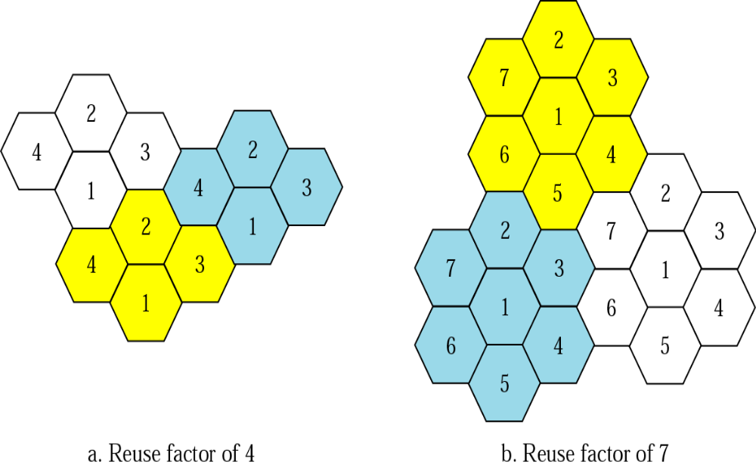
Frequency reuse…

Slide 5
Frequency reuse concept…
Consider a cellular system which has a total of S duplex channels.
Each cell is allocated a group of k channels, .
The S channels are divided among N cells.
The total number of available radio channels
S= kN
The N cells which use the complete set of channels is called cluster.
The cluster can be repeated M times within the system. The total number of channels, C, is used as a measure of capacity
C= MkN = MS
The capacity is directly proportional to the number of replication M.
The cluster size, N, is typically equal to 3, 4, 7, or 12.
Small N is desirable to maximize capacity.
Notes:
Advanteges
Solvestheproblemofspectralcongestionandusercapacity.
Offerveryhighcapacityinalimitedspectrumwithoutmajortechnologicalchanges.
Reuseofradiochannelindifferentcells.
Enableafixnumberofchannelstoserveanarbitrarilylargenumberofusersbyreusingthechannelthroughoutthecoverageregion.

Slide 6
Interference
Interference is a major limiting factor in the performance of cellular radio system
Sources of Interference
  Another mobile in the same cell
  A call in progress in a neighboring cell
  Other base stations operating in the same frequency band or
  Any non cellular system which inadvertently leaks energy into the cellular frequency band
The two major types of system generated interferences are
Co-channel interference
Adjacent channel interference
Notes:
Interference is a major limiting factor in the performance of cellular radio System.
It limits capacity and increase number of called dropped.
Our existing base station in cellular communication system are generally Omnidirectional, due to this the Signal power radiated throughout the cell area results in increase of the interference and reduce SNR due to undesired users.
Sector antenna will increase capacity of system by dividing entire cell into sector but have the same problem of interface.

Slide 7
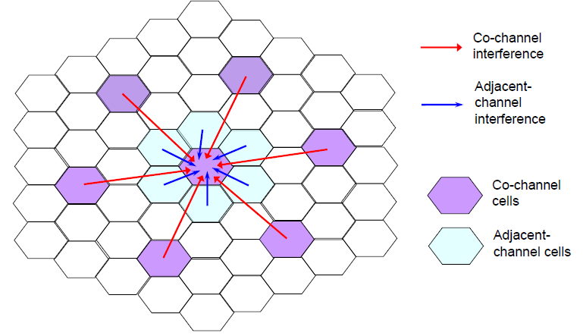
Co-channel & Adjacent channel Interference

Slide 8
Co-channel Interference
  CCI in a cell occurs due to the other cells that uses same frequency set of the cell.
  These cells using the same frequency set are called co-channel cell.
  The techniques to resolve the CCI
    Interference Reconstruction Technique (IRT)
    Equalization Techniques (ET)
    Design a Directional antenna
Notes:
One or more interfering signal are present in common receiver signal of interest
Cci –interference reconstruction from null space of SOI in time scale domain
Equalizer: render the frequency response

Slide 9
Adjacent Channel Interference
It is Interference resulting from signals which are adjacent in frequency to desired signal.
This results from imperfect receiver filters which allow nearby frequencies to leak into the pass band.
How can adjacent channel interference be reduced?
Careful filtering and channel assignment
By keeping the frequency separation between each channel in a given cell as large as possible
By sequentially assigning successive channels in the frequency band to different cells
Notes:
Occurs due to adjacent in frequency to desired signal ‘ happen due to imperfect receiver filter

Slide 10
Power Control For Reducing Interference
In practical cellular radio and personal communication systems the power levels transmitted by every subscriber unit are controlled by the serving base stations
Need for Power Control:
Received power must be sufficiently above the background noise for effective communication
Desirable to minimize power in the transmitted signal from the mobile. Reduce co-channel interference, alleviate health concerns, save battery power
In Spread Spectrum systems using CDMA, it’s desirable to equalize the received power level from all mobile units at the Base station.
Notes:
In open-loop PC, the mobilemeasures the pilot strength (continuously transmitted by the BS) which is related to path loss. If the pilot gets weak it powers-up, when the pilot gets strong it powers down.
In closed-loop PC, feedback is used whereby the base-station measures the signal-quality of mobile; e.g. frame error rate (FER) and commands each mobile to power up and down accordingly in order to keep the overall FER at desired level. –reverse link.

Slide 11
Improving Capacity in Cellular Systems
Cost of a cellular network is proportional to the number of Base Stations. The income is proportional to the number of users.
Techniques to provide more channels per coverage area is by
Cell Splitting : It allows an orderly growth of the cellular system
Sectoring : It uses Directional antennas to control the interference and frequency reuse of channels.
Zone Microcell: It distributes the coverage of the Cell.
More bandwidth
Borrow channel from nearby cells

Slide 12
Cell Splitting
Cell Splitting is the process of subdividing the congested cell into smaller cells (microcells),Each with its own base station and a corresponding reduction in antenna height and transmitter power.
Cell Splitting increases the capacity since it increases the number of times the channels are reused.
Cell Splitting allows the system to grow by replacing large cells with smaller cells without changing the co-channel re-use ratio Q.
The increased number of cells would increase the number of clusters over the coverage region, which in turn increase the number of channels, and thus capacity in the coverage area

Slide 13
Cell Sectoring
The co-channel interference in a cellular system can be decreased by replacing the omnidirectional antenna at the base station by several directional antennas, each radiating within a specified sector.
The process of reducing the co-channel interference and thus increasing the capacity of the system by using directional antennas is known as Sectoring.
In general a cell is partitioned into three 120 degree sectors or six 60 degree sectors.
When sectoring is employed, the channels used in a particular cell are broken down into sectored groups and are used only in a particular sector.

Slide 14
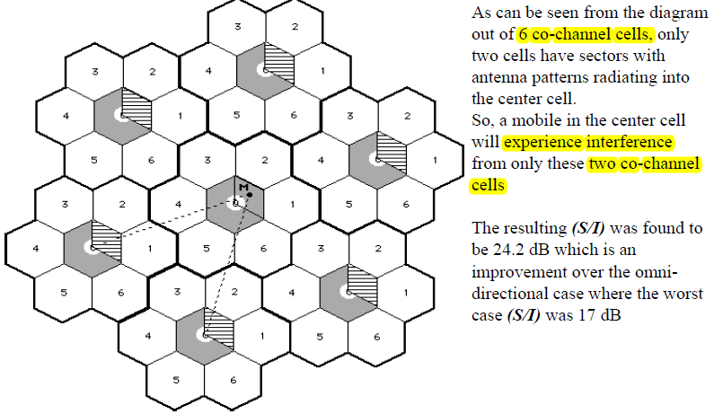
Cell sectoring …
Notes:
Disadvantages :
Increased number of antennas at each base station
Decrease in trucking efficiency due to channel sectoring at each base station
As sectoring reduces the coverage area of a particular group of channels, the number of handoffs increase.
Advantages Over Sectoring
As the mobile travels from one zone to another within the cell, it retains the same channel. Thus, a handoff is not required at the MSC
A given channel is active only in the particular zone in which the mobile is traveling and hence the base station radiation is localized and interference is reduced
The co-channel interference is also reduced as a large base station is replaced by several lower powered transmitters on the edges of the cell

Slide 15
Mobility management in cellular network
Mobility management is one of the major function of a GSM and UMTS network that allows mobile phone to the network.
It’s main aim to track where the subscribers are allowing calls, MS and other mobile phone service to be delivered to them.
Mobility management enables the serving networks to locate a mobile subscriber’s point of attachment.
  For delivering data packets (i.e. location management), and
  maintain a mobile subscriber’s connection as it continues to change its point of attachment (i.e. handoff management).
This may be concern with
      Handoff management and
      Location management (Roaming)
Notes:
UMTS= universal mobile telecommunication services
PCS refers to any of several types of wireless voice or wireless data communications systems, typically incorporating digital technology, providing services similar to advanced cellular mobile or paging services.
Personal Communications Services (PCS) A new generation of wireless-phone technology that introduces a range of features and services surpassing those available in analog- and digital-cellular phone system.
The Mobile station(MS) area is covered a set of base station(BS) which are responsible for relaying the cell to and from the mobile station (MS) located in their coverage area(cell).
It is also referred to as handset, mobile phone, subscriber unit, or portable(hardware and the SIM)
It contains a number known as the International Mobile Equipment Identity (IMEI) which installed in the phone at manufacture and “cannot” be changed.
SIM or Subscriber Identity Module contains the information that provides the identity of the user to the network.

Slide 16
Handoff Management
Handoff management is the process by which a mobile node keeps its connection active when it moves from one access point to another.
The term, handoffs is used when a subscriber wonders in the cells in a local cellular system in cellular technology.
When a person travels among different cellular systems in many countries or the city then it is called that he is in roaming.
There are three stages in a handoff process.
  First, the initiation of handoff is triggered by either the mobile device, or a network agent, or the changing network conditions.
  The second stage is for a new connection generation, where the network must find new resources for the handoff connection and perform any additional routing operations.
  Finally, data-flow control needs to maintain the delivery of the data from the old connection path to the new connection path according to the agreed-upon QoS guarantees.

Slide 17
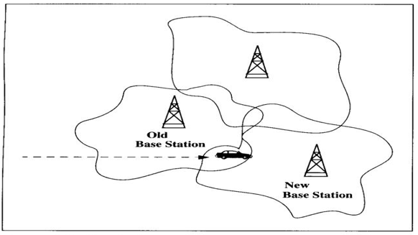
Hand off management…
    When mobile user engaged in conversation the MS connected to BS via radio link.
    The mobile user move to coverage area of anther BS, the radio link to the old BS eventually disconnected and the radio link to the new base station should be stablished to continue the conversation.
    This process is variously referred to as automatic link transfer ,handover or hand off.

Slide 18
Handoff management …
As shown in the above figure we consider three base stations.(BSs) and there coverage areas.
Here MS is a Vehicle traversing in the coverage areas.
The coverage areas are irregular because of the radiation patterns of these base station antennas, buildings, trees, mountains and other terrain futures.
Here the Ms continue the Conversation the handoff procedure should be completed while the MS is in overlap region.
As the MS moves towards the edge of the BS coverage area the signal strength and quality begin to deteriorate .
At some point signal from New BS stronger than serving Old BS.
So that the signal is necessary to handed over to the new BS from old BS ,before MS becomes unusable. Otherwise call will lost.

Slide 19
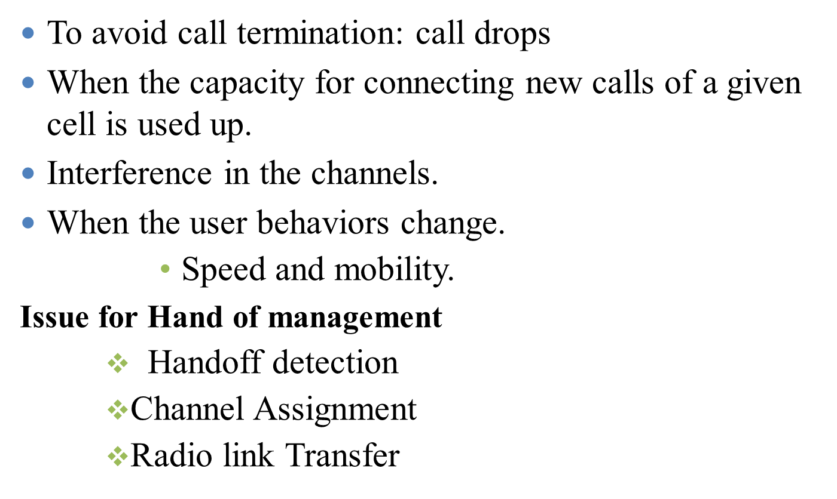
Reasons for a Handoff to be conducted

Slide 20
Issue for Hand of management
    Handoff detection
Handoff detection is based on link measurement
Signal measurement is used to determine the qualities of the channel
    WEI(world error indicator) : Metric that indicate weather the current burst was demodulate properly in the MS
    RSSI( received signal indicator)
    QI(quality indicator)
      signal to interface and noise Ratio
To make the handoff decision accurately and quickly it is desirable to use both WEI (over a periodic of time )and RSS (instantaneously)
Unreliable and inefficient handoff procedure will reduce the quality and reliability of the system.
RSS measure are affected by fading
Notes:
Handoff criteria
If no chosen appropriately then the call might be handed back and forth several time between two adjacent Bs
If too conservative then the call may be lost before the handoff

Slide 21
Issue for Hand of management…
Fading
Fading: time variation of received signal power due to change in transmission medium or path.
Caused by interference from multiple copies of Tx signal arriving @ Rx at slightly different times
Three most important effects:
  Rapid changes in signal strengths over small travel distances or short time periods.
  Changes in the frequency of signals.
  Multiple signals arriving a different times. When added together at the antenna, signals are spread out in time. This can cause a smearing of the signal and interference between bits that are received.
  Fading concept can be generalized as the following

Slide 22
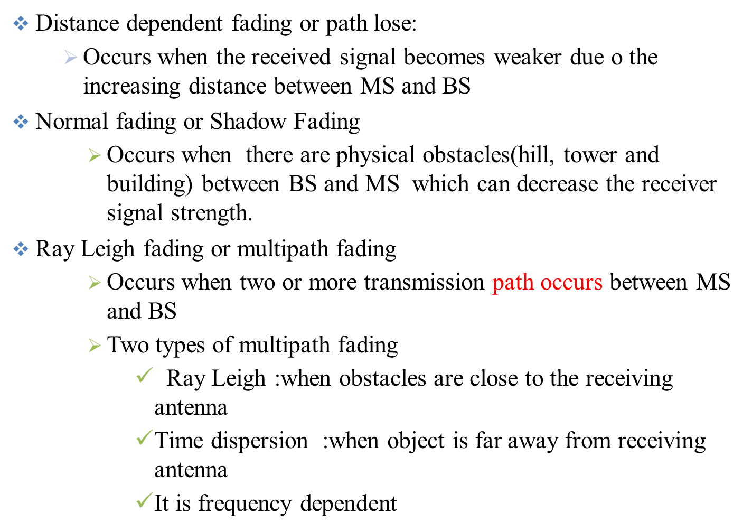
Issue for Hand of management…
Notes:
Short term Rayleigh fading is handled in mobile system designs by :
frequency hopping and multiple receivers
Signal processing technique such as bit interleaving, equalizers.
Long term channel fading is compensated by increasing transmitter power and the co-channel reuse distance.

Slide 23
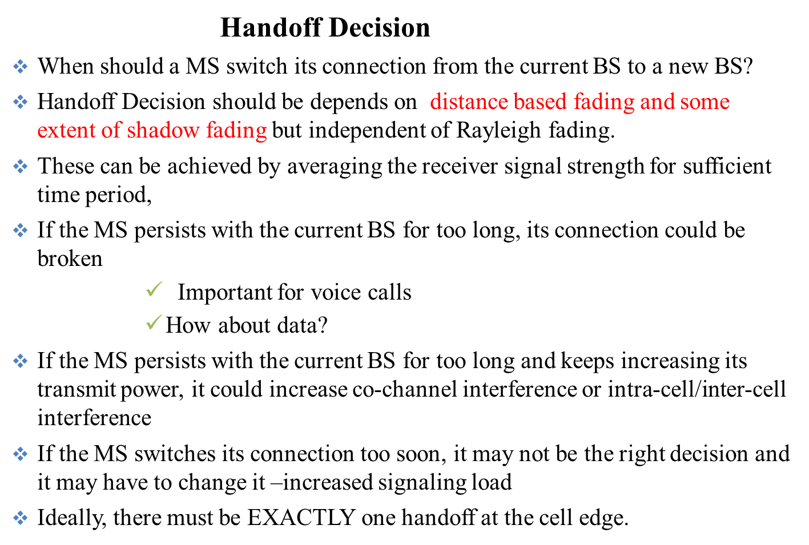
Issue for Hand of management…

Slide 24
Strategies for Handoff Detection
    Mobile Controlled Hand off(MCHO)
    Network Controlled Handoff(NCHO)
    Mobile assisted Hand off(MAHO)

Slide 25
Mobile Controlled Hand off(MCHO)
The Mobile station controlled the signal of surrounding BS and interference levels on all channels then initiate the handoff process when some criteria's are met.
Each MS is completely in control of the handoff process and the MH is responsible for initiating a handover.
If the signal strength of the serving BS is lower than that of another BS by a certain threshold, then handoff can be initiated.
It does this by evaluating the signal strength and traffic load conditions and detecting the presence of neighbouring BSs.
When a MH decides to initiate a handover, it sends an explicit message to a mobility management node residing in the network.
This type of handoff has a short reaction time (on the order of 0.1 second).
Popular for lower tier radio systems.
It Used in DECT and PACS

Slide 26
MCHO…
Their are two common handoffs:
Automatic link transfer (ALT)
    Transfer between two base stations
    Requires the MS to make quality measurement of current and candidate channels in surrounding BS.
Time slot transfer
    Transfer between channels of a single BS
    The MS’S handoff control between channels on the same BS is made possible by passing uplink quality information in the form of word –error indicator ,back to the MS on Downlink.
    The MS obtain RSSI and QI process information a part of modulation.

Slide 27
Network Controlled Handoff(NCHO)
The network controlled handoff scheme a signal strength monitor object, running in a wireless access point, continuously measures the signal strength of a mobile device.
The surrounding BS measure the signal for MS the network initiates the handoff process when some handoff criteria's are met.
handoff decisions are based on the measurements of the MSs at a number of BSs and these decisions are made by the network.
Connection rerouting is performed by the network and network collects statistics related to signal strength, traffic load, and other information to decide when to initiate a handover and which new BS is the target.
Used in CT-2 plus and AMPS

Slide 28
NCHO…
Network uses multiple (current and surrounding) BSs to supervise quality of all current connections by making measurements of RSSI.
MSC will command surrounding BSs to occasionally make measurements of these links.
MSC makes the decision when and where to effect the handoff
Heavy network signalling traffic and limited radio resource at BSs prevent frequency measurement's of neighbouring links=> long Handoff times (>10s)

Slide 29
Mobile Assisted Handoff(MAHO)
In this strategy the network makes decisions and the MS makes measurements.
It is a process used in GSM cellular networks where a mobile phone assists/helps the cellular base station to transfer a call to another base station
It is a technique used in mobile telecom to transfer a mobile phone to a new radio channel with stronger signal strength and improved channel quality.
The network asks the mobile station to measure the signal from surrounding BSs.
The network makes the handoff decision based on report from the MS.
Handoff process is more decentralized.
Used in GSM in IS-95 CDMA

Slide 30
Types of handover
They are categorized as Hard handoff and Soft handoff
Soft handoff(“Make-before Break "Handoff)
It is a mobile cellular network technology commonly used in CDMA (Code-division multiple access) systems that enables the overlapping of the repeater coverage zones,
So that every mobile station is always well within range of at least one of the base stations.
Soft handoff mechanism works by first switching and establishing connection with another base station before disconnecting from the existing base station in the network.
There is no change in frequency or timing as a mobile set passes from one base station to another base station,
Notes:
They are also characterized by “make before break” and “break before make”.
In the soft handoff, during the handoff process, both existing and new resources are used but in hard handoff, current resources are released before new sources are used.

Slide 31
Cont’d
so there are practically no dead zones therefore the connections face negligible interruption and the dead zones are practically non existent.
If compared to hard handover, Soft handover offers more reliable access continuity in network connection and less chances of a call termination during switching of base stations.
This is due to it inherent attribute to handle simultaneous frequency channels which rarely suffer from fading or interference at the same time and together.
In soft handoff technology, the connections are relatively permanent and the communication is more stable in comparison to the other cellular technologies because in CDMA technology, all the repeaters use the same frequency channel for each mobile set, irrespective of the location.

Slide 32
Soft handoff procedure
Suppose that the mobile station is linked and communicating with base station 1:
Every base station is sending a pilot signal, which among other things, gives a measure of the signal strength to mobile users.
When the signal strength of base station 2 exceeds the add threshold, base station 1 is notified to place base station 2 onto the candidate list.
Further, when the signal strength of base station 2 becomes greater than that of base station 1 by some specified level, Base station 2 is placed on the active list and it also is allowed control of the call.
Now upon the signal level of base station 1 going below the drop threshold, the drop timer is activated.
Notes:
Advantages of soft handover over hard handover:
1) In soft handoff, during handoff execution mobile does not lose contact with the system. 2) Ping ponging is eliminated and an extra measure of performance is obtained through diversity combining to mitigate fading. 3) More control may be given to the mobile in handoff decisions.

Slide 33
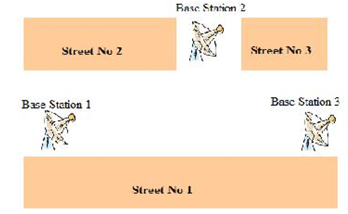
Soft handoff procedure…
If it happens now that the signal level of base station 1 goes back above the drop level, the drop timer will be reset.
However, if the signal strength level goes below the drop threshold and the drop timer expires; base station1 is dropped from activity with the call.
Notes:
Advantages of Soft Handover:
i) In soft handovers the connection to the source cell is broken only when a reliable connection to the target cell has been established and therefore there are lower chances that the call will be terminated abnormally due to failed handovers. ii) Other advantage is that simultaneously channels in multiple cells are maintained and the call could only fail if all of the channels are interfered or fade at the same time.
2) Disadvantage of Soft Handover: The main disadvantage of soft handovers is that it uses several channels in the network to support just a single call. So the number of remaining free channels is reduced and thus the capacity of the network also reduces.

Slide 34
Cont’d….
Hard hand off(“break before make” )
In hard handoff, the link to the prior base station is terminated before or as the user is transferred to the new cell’s base station.
This means that the mobile station is linked to no more than one base station at a given time.
Under the control of the MSC, the BS hands off the MS’s call to another cell and then drop the call.
Initiation of the handoff may begin when the signal strength at the mobile received from base station 2 is greater than that of base station 1.
The signal strength measures are really signal levels averaged over a chosen amount of time.

Slide 35
Cont’d..
This averaging is necessary because of the Rayleigh fading nature of the environment in which the cellular network resides.
A major problem with this approach to handoff decision is that the received signals of both base stations often fluctuate.
Hard handoff is primarily used in FDMA (frequency division multiple access) and TDMA (time division multiple access), in which different frequency ranges are used in adjacent channels in order to minimize channel interference.
So it becomes impossible to communicate with both BSs when the MS moves from one BS to another BS (since different frequencies are used).
A disadvantage of hard handover is that if a handover fails the call may be temporarily disrupted or even terminated abnormally.
Notes:
Advantages of Hard Handover:
i) An advantage of the hard handover is that at any moment in time one call uses only one channel. The hard handover is usually not perceptible by the user and the event is indeed very short. ii) Another advantage of the hard handover is that it is cheaper and simpler because the phone's hardware does not need to be capable of receiving two or more channels in parallel.

Slide 36
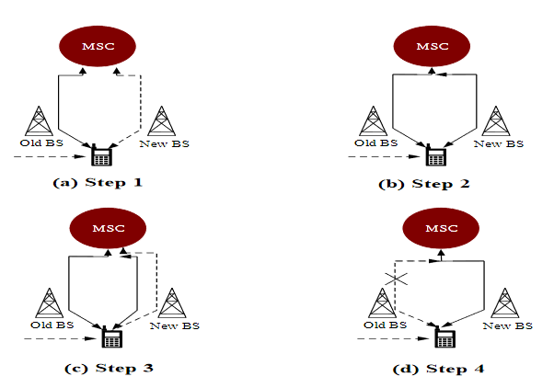
Types of handover ….
Inter-BS handoff(inter- cell)

Slide 37
Inter-BS handoff…
The new and old BSs are connected to the same MSC. Assume that MCHO is adopted here.
When the need of handoff detected by MS :
Step 1.The MS momentarily suspends conversation and initiates the handoff procedure by signaling on an idle channel in the new BS. Then it resumes the conversation on the old BS.
Step 2.Upon receipt of the signal, the MSC transfers the encryption information to the selected idle channel of the new BS and sets up the new conversation path to the MS through that channel. The switch bridges the new path with the old path and informs the MS to transfer from the old channel to the new channel.
Step 3.After the MS has been transferred to the new BS, it signals the network, and resumes conversation using the new channel.
Notes:
type of handover, in which the source and the target are different cells (even if they are on the same cell site), is called inter-cell handover. So the purpose of inter-cell handover is to maintain the call as the subscriber is moving out of the area covered by the source cell and entering the area of the target cell.

Slide 38
Inter BS handoff…
Step 4.Upon receipt of the handoff completion signal, the network removes the bridge from the path and releases resources associated with the old channel.
This handoff procedure used with mobile control handoff strategies (MCHS)
For the network controlled handoff strategy ,all handoff signaling messages are exchanged between MS and the old BS through the failing link
The whole process must be completed as quickly as possible ,to ensure that the new is established before the old link fails.
This handoff reduce the probabilities of force termination and call incompletion(new call blocking pulse handoff call forced termination)
Notes:
When no available channel the new call is blocked
One distinguishes between two kinds of blocking, the first is called new call blocking and refers to blocking of new calls, and the second is called handoff blocking and refers to blocking of ongoing calls due to the mobility of the users.

Slide 39
Inter-BS handoff…
If the new BS does not have an idle channel, the handoff call may be dropped (forced to terminate).
Forced termination of an ongoing call is considered less desirable than blocking a new call attempt.
In most PCS handoff handling method if no channel is available the handoff is blocked the call is held on current channel in the old cell until call is completed when fail link is no longer available .
This method referred to as non prioritized scheme
The main purpose of inter-BS handover is to maintain the call as the subscriber is moving out of the area covered by the source cell and entering the area of the target cell.
Notes:
Intra-cell Handover: In this handover, the source and the target are one and the cell is same and only the used channel is changed during the handover. So in this handover, in which the cell is not changed, is called intra-cellhandover and the purpose of intra-cell handover is to change one channel, which may be faded or interfered with a new clearer or less fading channel.

Slide 40
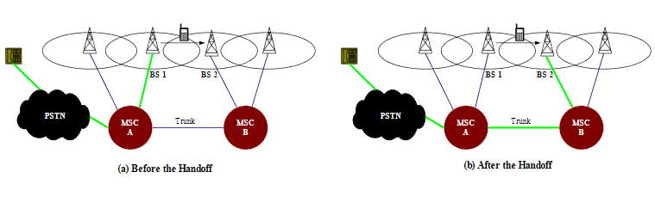
Intersystem Handoff(inter -MSC)
In intersystem handoff, the new and old BSs are connected to two different MSCs.

Slide 41
Cont’d..
Step 1.
  Part I.MSC A requests MSC B to perform handoff measurements on the call in progress.
  Part II.MSC then selects a candidate BS “BS 2”, and interrogates BS 2 for signal quality parameters.
  Part III.MSC B returns the signal quality parameters, along with other relevant information, to MSC A.
Step 2.
  Part I.MSC A checks if the MS has made too many handoffs recently (e.g., to avoid that MS is moving within overlapped area) or if intersystem trunks are not available.
  Part II. If so, MSC A exits the procedure.
  Part III. Otherwise, MSC A asks MSC B to set up a voice channel.
Step 3.
  Part I.MSC A sends the MS a handoff order.
  Part II. The MS synchronizes to BS 2.
  Part III. After the MS is connected to BS 2, MSC B informs MSC A that the handoff is successful.
  Part IV.MSC A then connects the call path (trunk) to MSC B.
MSC A is referred to as the anchor MSC, and is always in the call path before and after the handoff.

Slide 42
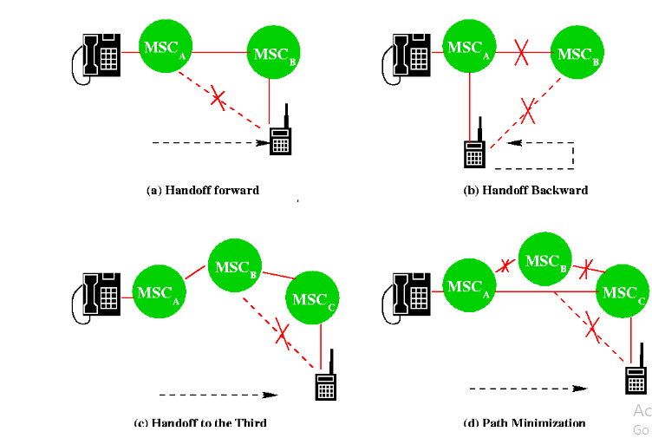
Anchor Approach
The Anchor Approach is used in all existing mobile phone networks because the re-establishment of a new call path (without involving MSC A) between MS and the new MSC would require extra trunk release/setup operations in PSTN.
If the MS moves back to MSC A again, the connection between MSC A and MSC B is removed(handoff backward).
If the MS moves to the third MSC C, then MSC B will be in the call path(handoff to third).
Path Minimization. When the MS moves to the third MSC, the second MSC may be removed from the call path. The link between MSC A and MSC B is disconnected, and MSC MSCC is connected MSC A directly.

Slide 43
Channel Assignment Schemes for Handoff Calls
To reduce force termination and promote call completion channel assignment scheme have ben proposed.
Non prioritized Scheme.
    The networks handle a handoff in the same manner as a new call attempt.
Reserved Channel Scheme.
    Similar to the non prioritized scheme, except that some channels in each BS are reserved for handoff calls.
Queuing Priority Scheme.
    There is a considerable area where a call can be handled by either BS, which is called the handoff area.
    If no new channel is available in the new BS during handoff, the new BS buffers the handoff request in a waiting queue.
    The MS continues to use the channel with the old BS until either a channel in the new BS becomes available.
Notes:
When no available channel the new call is blocked
One distinguishes between two kinds of blocking, the first is called new call blocking and refers to blocking of new calls, and the second is called handoff blocking and refers to blocking of ongoing calls due to the mobility of the users.

Slide 44
Cont’d…
4. Sub rating Scheme.
  The new BS creates a new channel for a handoff call by sharing resources with an exiting call if no free channel is available.
  Sub rating means an occupied full-rate channel is temporarily divided into two channels at half the original rate.
  One half-rate channel is to serve the exiting call, and the other half-rate channel is to serve the handoff request.
  When occupied channels are released, the sub rated channels are immediately switched back to full rate channels.
Notes:
Inter BS scheme reduce the probabilities of force termination as well as the probablties of call in incompletion(new call blocking plus handoff call forced termination))

Slide 45

Summery of handoff

Slide 46
Chapter Three part 2
Roaming management
Wireless Mobile Networks(CSE5309)

Slide 47
2. Roaming management
RM Ensure that a mobile phone remains connected to a mobile network while the subscriber is abroad, or outside of the geographical coverage area of the home country network.
When user move from one PCS system the system should be informed of the current location of the user to deliver the service to the mobile user.
Roaming means when our phones receives phone signal whenever we are outside of our cell phone carriers operation area.
Roaming charge may apply when we travel and leave home network area and roam onto the network or coverage area of another provider.
support mobility management protocol such as EIA /TIA , Interim standard (IS-41 )or ANSI 41 ,Global system for mobile (GSM), mobile application part (MAP) have been defined for PCS networks.
Notes:
wireless telecommunication term typically used with mobile devices, such as mobile phones. It refers to the mobile phone being used outside the range of its home network and connects to another available cell network.
Mobile data: internet access via mobile signal 3g.4g
Data roaming :when our mobile phone is using data on mobile network away from our home network while we are abroad

Slide 48
Cont’d….
The Two basic operations in roaming management are:
    Registration (or Location Update):the process whereby a MS informs the system of its current location.
    Location Tracking: The process during which the system locates the MS (this process is required when the network attempts to deliver a call to the mobile user)
The roaming management schemes proposed in IS-41 and GSM and MAP are two-level strategies
They use a two-tier system of home and visited databases that are
        Home Location Register (HLR), and
        Visited Location Register (VLR).

Slide 49
Home Location Register (HLR)
This database contains all the administrative information about each subscriber along with their last known location.
In this way, the GSM network is able to route calls to the relevant base station for the MS.
When a user subscribes to the services of a PCS network, a record is created in the system’s database, which is referred as to the home system of the mobile user.
HLR is a network database that stores and manages all subscriptions of a specific operator.
The information contained in HLR includes
        MS Identity,
        directory number,
        profile information,
        current location,
        validation period.

Slide 50
Visitor Location Register (VLR)
This contains selected information from the HLR that enables the selected services for the individual subscriber to be provided.
The VLR can be implemented as a separate entity, but it is commonly realized as an integral part of the MSC, rather than a separate entity.
When the mobile user visits a PCS network other than the home system, a temporary record for the mobile user is created in the visitor location register (VLR) of the visited system.
The VLR temporarily stores subscription information for the visiting subscribers.
Thus, the MSC (corresponding with the VLR) can provide service to the mobile user.
The VLR is the “other” location register used to retrieve information for handling calls to/from a visiting mobile user.

Slide 51
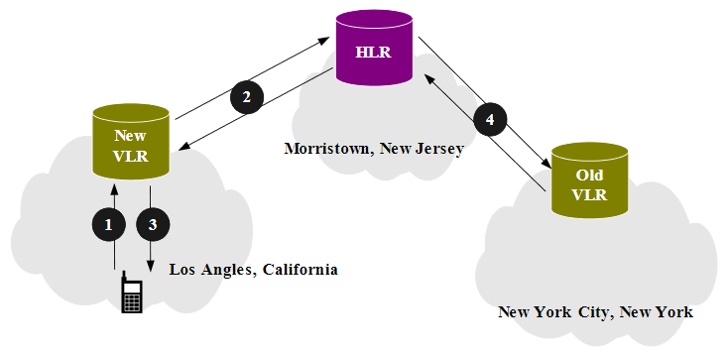
MS Registration Process

Slide 52
Cont’d…
Step 1.
Suppose that the home system of a mobile user is in Morristown. When the mobile user moves from one visited system (e.g., New York City) to another (e.g., Los Angeles), it must register in the VLR of the new visited system.
Step 2.
Part I. The new VLR informs the mobile user’s HLR of the person’s current location-the address of the new VLR.
Part II. The HLR sends an acknowledgement, which includes the MS’s profile, to the new VLR.
Step 3.
The new VLR informs the MS of the successful registration.
Step 4.
After Step 2, the HLR also sends a deregistration message to cancel the obsolete location record of the MS in the old VLR.
The old VLR acknowledges the deregistration.

Slide 53
Call Origination(delivery) Procedure
To originate a call, the MS executes the following steps.
Step 1.MS contacts the MSC in the visited PCS network.
Step 2.The call request is forwarded to the VLR for approval
Step 3.If the call is accepted, the MSC sets up the call to the called party following the standard PSTN call setup procedure.

Slide 54
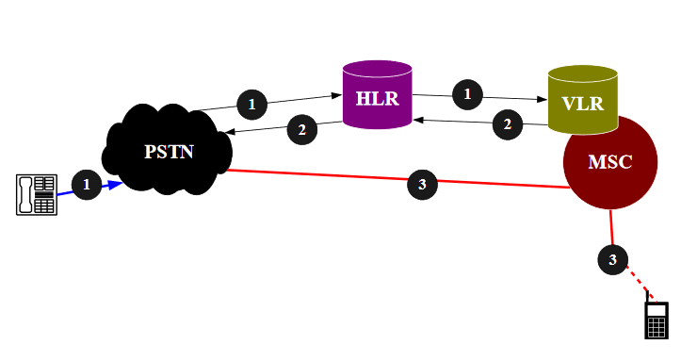
Call Delivery (Call Termination/Location Tracking)

Slide 55
Cont’d…
Step 1.
Part I. If a wireline phone attempts to call a mobile subscriber, the call is forwarded to a switch, called the originating switching the PSTN.
Part II. The originating switch queries the HLR to find the current VLR of the MS.
Part III. The HLR queries the VLR in the which the MS resides to get a routable address.
Note that if the originating switch is not capable of querying the HLR (i.e., it is not equipped to support mobility), the call is routed through the PSTN to the subscriber’s Gateway MSC, which queries the HLR to determine the current VLR serving the MS.
Step 2.The VLR returns the routable address to the originating switch through HLR.
Step 3.Based on the routable address, a trunk (voice circuit) is set up from the originating switch to the MS through the visited MSC.

Slide 56
Roaming Management under SS7
Mobile roaming managed by the PSTN signaling through SS7
SS7 is developed to satisfy the telephone operating companies’ requirement for an improvement to the earlier signaling systems, which is lacked the sophistication required to deliver mush more than plain old telephone service(POTS).
Signaling between a PCS network and the PSTN are typically achieved by the SS7 network.
Notes:
SS7:(signaling system 7): define how network element in PSTN exchange information over a digital signaling network.

Slide 57
Common Channel Signaling (CCS)
CCS is a out-of-band signaling network that provides control and management functions in the telephone network.
    CCS consists of
    supervisory functions
    Addressing
    Call Information Provisioning
Functions provided by CCS are:-
    To convey messages to initiate and terminate calls
    To determine the status of some part of the network
    To control the amount of traffic allowed
CCS uses a separate out of band signaling network to carry signaling messages.

Slide 58
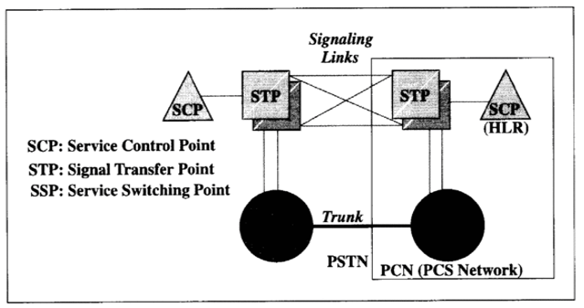
Distinct Components of SS7
Service Switching Point (SSP)
A telephone switch interconnected by SS7 links.
The SSPs perform call processing on calls that originate, tandem, or terminate at that nodes.
A Local SSP in the PSTN can be central or end office (EO).
An SSP in a PCS network is called a mobile switching center (MSC).
Notes:
Compentants of ss7=3

Slide 59
Cont’d…
Signal Transfer Point (STP)
  A switch that reply SS7 message between network switched and databases.
  Based on the address fields of the SS7 messages, the STPs route the message to the correct out-going signal links.
  For the reliability requirements, STPs are provisioned in mated pairs.
Service Control Point (SCP)
  SCP contains data bases for providing enhanced services.
  An SCP accepts queries from an SSP and returns the requested information to the SSP.
  In mobile applications, an SCP may contains an HLR or VLR.
  In SS7 network, the trunks (voice circuits) connects SSPs to carry user data/voice information.
The signaling links connects SCPs to STPs, and STPs to SSPs.
The SSPs and SCPs are connected indirectly through STPs.

Slide 60
Registration through SS7
Example: the MS moves from VLR1 to VLR2.
Step 1
  The MS enters the area controlled by MSC2.
  MSC 2 lunches a registration query to its VLR through STP2, assuming that VLR2 and MSC2 are not co-located.
  Step 2
  VLR2 sends a registration message to the MS’s HLR (HLR4)
  VLR2 may not know the actual address of HLR. Instead, VLR2 sends the message to containing the MS identity, called Mobile Identification Number(MIN), to an STP (STP3) that can translate the MIN into the HLR address.
  Step 3
  The MIN-to-HLR address translation is performed at STP3 by a table-lookup technique called Global Title Translation(GTT). STP3 the forwards the registration message to HLR

Slide 61
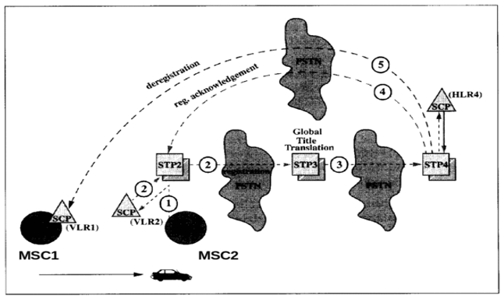
Cont’d…
Step 4
After the registration, HLR sends an acknowledgement back to VLR2. Since the address of VLR2 is known, the acknowledgement may be sent to VLR2 using a shortcut, without passing through STP3.
Step 5
After Step 3, HLR sends a deregistration message to VLR1 to cancel the obsolete record. VLR1 then acknowledges the cancellation.

Slide 62
Reducing the “Cost "of Deregistration
Approach 1: Implicit Deregistration
  Obsolete VLR records are deleted until the database is full.
  If the database if full when an MS arrives, a record is deleted, freeing storage space to accommodate the newly arrived MS.
  A replacement policy is required to select a record for replacement. (Note that a valid record is replaced, and the information is lost).
Advantage
  No deregistration message are sent among the SS7 network elements.
Notes:
Obsolete=old

Slide 63
Cont’d….
Approach 2: Periodic Re-registration .
  The MS periodically re-registers to the VLR.
  If the VLR does not receive the re-registration message within a timeout period, the record is deleted
Advantage
  This approach only creates local message traffic between the MSC and the VLR.
  No SS7 messages are generated if the VLR is co-located with the MSC.

Slide 64
Reducing the Registration Traffic–Pointer Forwarding Scheme
Move Operation (registration)
  When an MS moves from one VLR to another, a pointer is created from the old VLR to the new VLR.
  No registration to the HLR is required.
Find Operation (call delivery)
  When the HLR attempts to locate the MS for call delivery, the pointer chain is traced.
  After the find operation, the HLR points directly to the destination VLR.

Slide 65
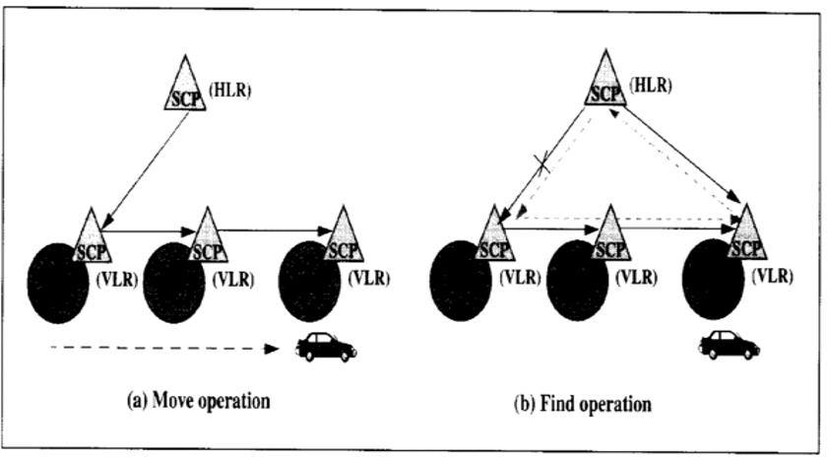
Cont’d…
figure. Pointer forwarding scheme

Slide 66
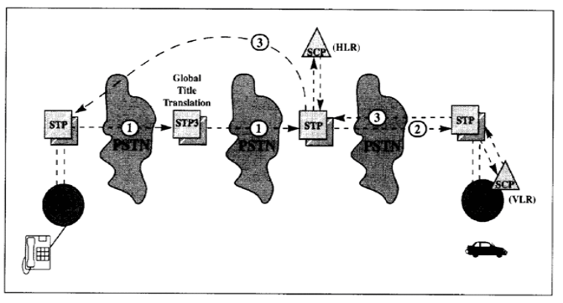
Cont’d…
Call Delivery through SS7
Similar to the registration process, visited to several STPs, and a GTT maybe required to access the HLR in call delivery
Several STPs may be visited to obtain the routable address from the VLR.
To reduce the call delivery traffic, a cache scheme was proposed.
figure .Call delivery through SS7
Notes:
GTT= global title translation

Slide 67
Cont’d….
Cache Scheme
The possible positions for the cache,
  Method 1:The cache is maintained in the originating SSPs.
  Method 2: The cache is maintained in the STP that performs GTTs.
A cache entry consists of two fields:
  The MIN of an MS
  The current visited VLR of the MS
The cache contains entries for MSs recently accessed from the SSP.

Slide 68
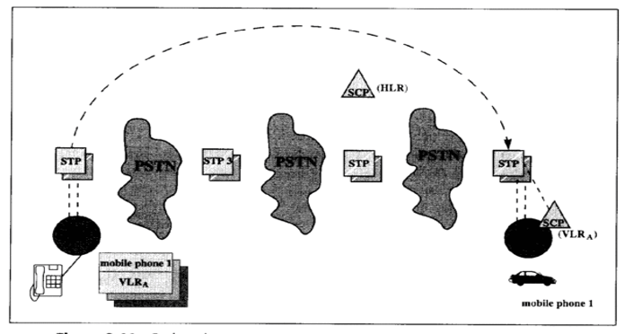
Cont’d…
Figure Cache scheme

Slide 69
Cont’d….
When the calling party originates a call to an MS, the SSP first checks if the cache entry for the MS exists. Three possibilities are
  Case 1: The cache entry does not exists
      The call delivery is processed following the normal procedure
  Case 2: The cache entry exists and is current
      The VLR is directly accessed.
  Case 3: The cache entry exists but is obsolete
      Then procedure detects that the cache entry is obsolete if the queried VLR’s response is negative. The normal procedure is executed.

Slide 70
Cont’d….
Roaming Management for CT2
In a public environment, CT2 is a one-way calling PCS system
      A CT2 handset can originate calls, but cannot receive incoming calls.
To construct two-way calling mechanism into CT2
Call Delivery Procedure
Step 1 :When the calling party dials the number of a CT2 handset, a voice trunk is set up from the originating switch to the CT2 switch S1.
Step 2 :S1 queries the location register to identify the area controller of the handset.
Step 3 : An alerting message is sent from S1 to the corresponding area controller via the PSDN.
      The area controller then broadcasts the alerting message to the connected BSs to page the handset.
Step 4 : „If the handset responds, the corresponding base station redials to S1 through PSTN.
Step 5: S1 bridges the two trunks, and the conversation begins.

Slide 71


